Slide 1

Exploratory Data Analysis
G2M Case Study
15/July/2022

Slide 2
Background of Study
Who are we studying?
XYZ is a private equity firm in the US.
The main point of this study is to create a feasible investment opportunity within the Cab Industry.
The two Cab Companies at focus are Yellow and Pink Cab co.
Objective:
How can we create valuable insight for which Cab Company that XYZ should invest in?

Slide 3
Agenda
How will this presentation be organized?
Exploratory Data Analysis (Data Format/Manipulation)
Spatial Consumer Density
Consumer Characteristics
Profit Analysis/forecasting
Recommendations for investment opportunity

Slide 4
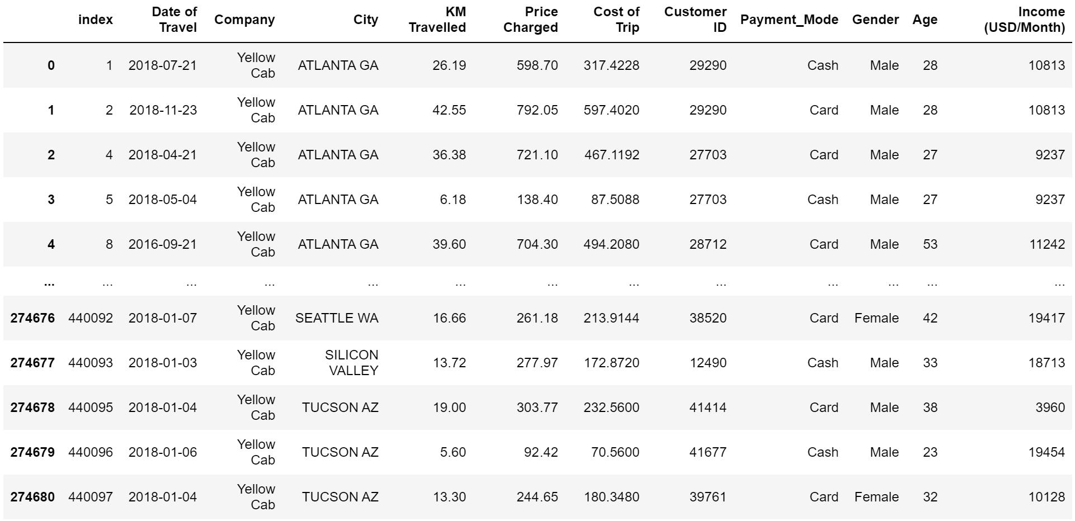
Data Manipulation
In total, 4 .CSV files were used.
Cab_Data.csv
City.csv
Customer_ID.csv
Transaction_ID.csv
All files were merged and joined to create a final DataSet

Slide 5
Data Format
# of Features: 11
# of Observations: 359,392
Time frame: 31/01/2016 – 31/12/2018

Slide 6
Assumptions
Dedupe Validation:
Every observation will be checked for duplication in an iterative manner. If any arise, they will be dropped.
Our data is not skewed. (No outliers)
All missing data will be dropped from the dataset.
An ongoing calculation of profit will be the difference between cost of trip and price charged.

Slide 7
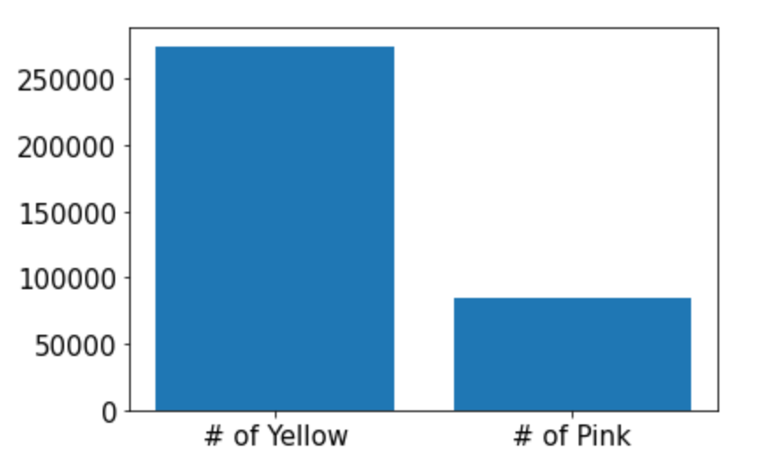

Company EDA
We can see that there is a larger number of Yellow cabs compared to Pink Cabs. This analysis may yield some interesting results in the customer frequency per state.

Slide 8
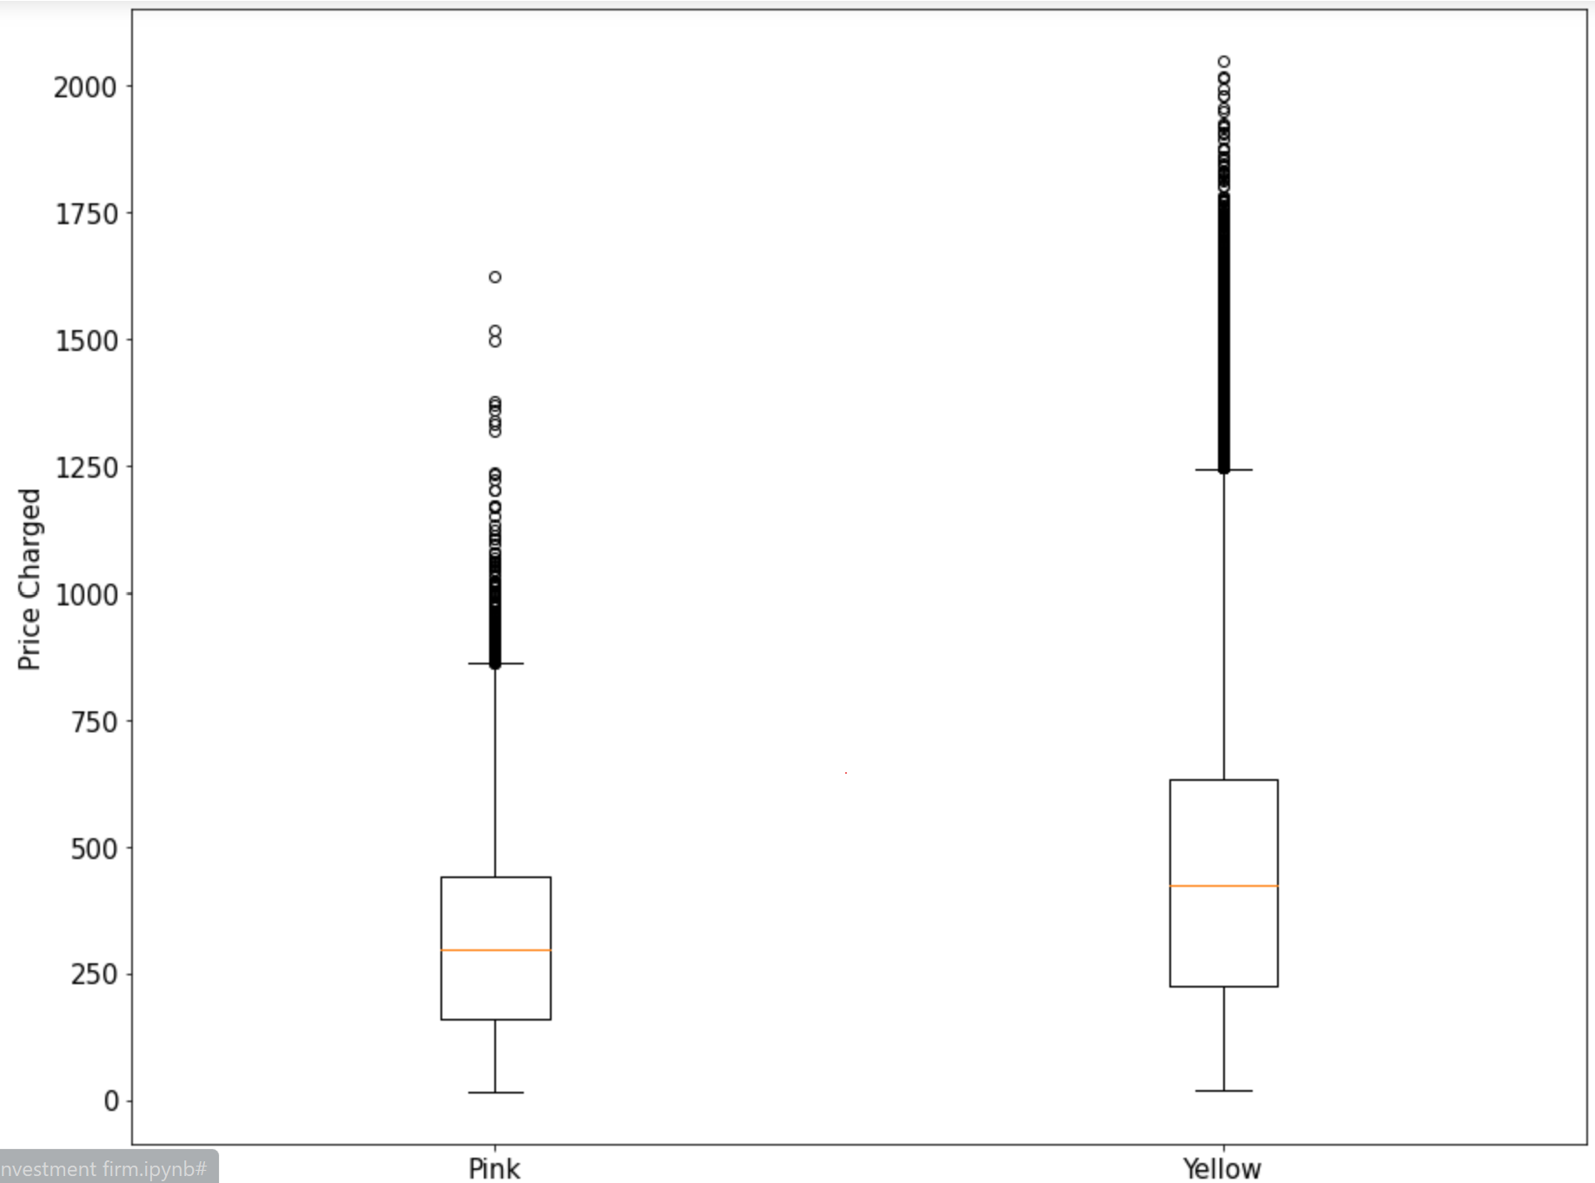
Company EDA 2
Looking more in-depth in the distribution of price charged, we can see that Yellow has a more skewed distribution that Pink. This means that overall, Yellow charges, on average, more than Pink.

Slide 9
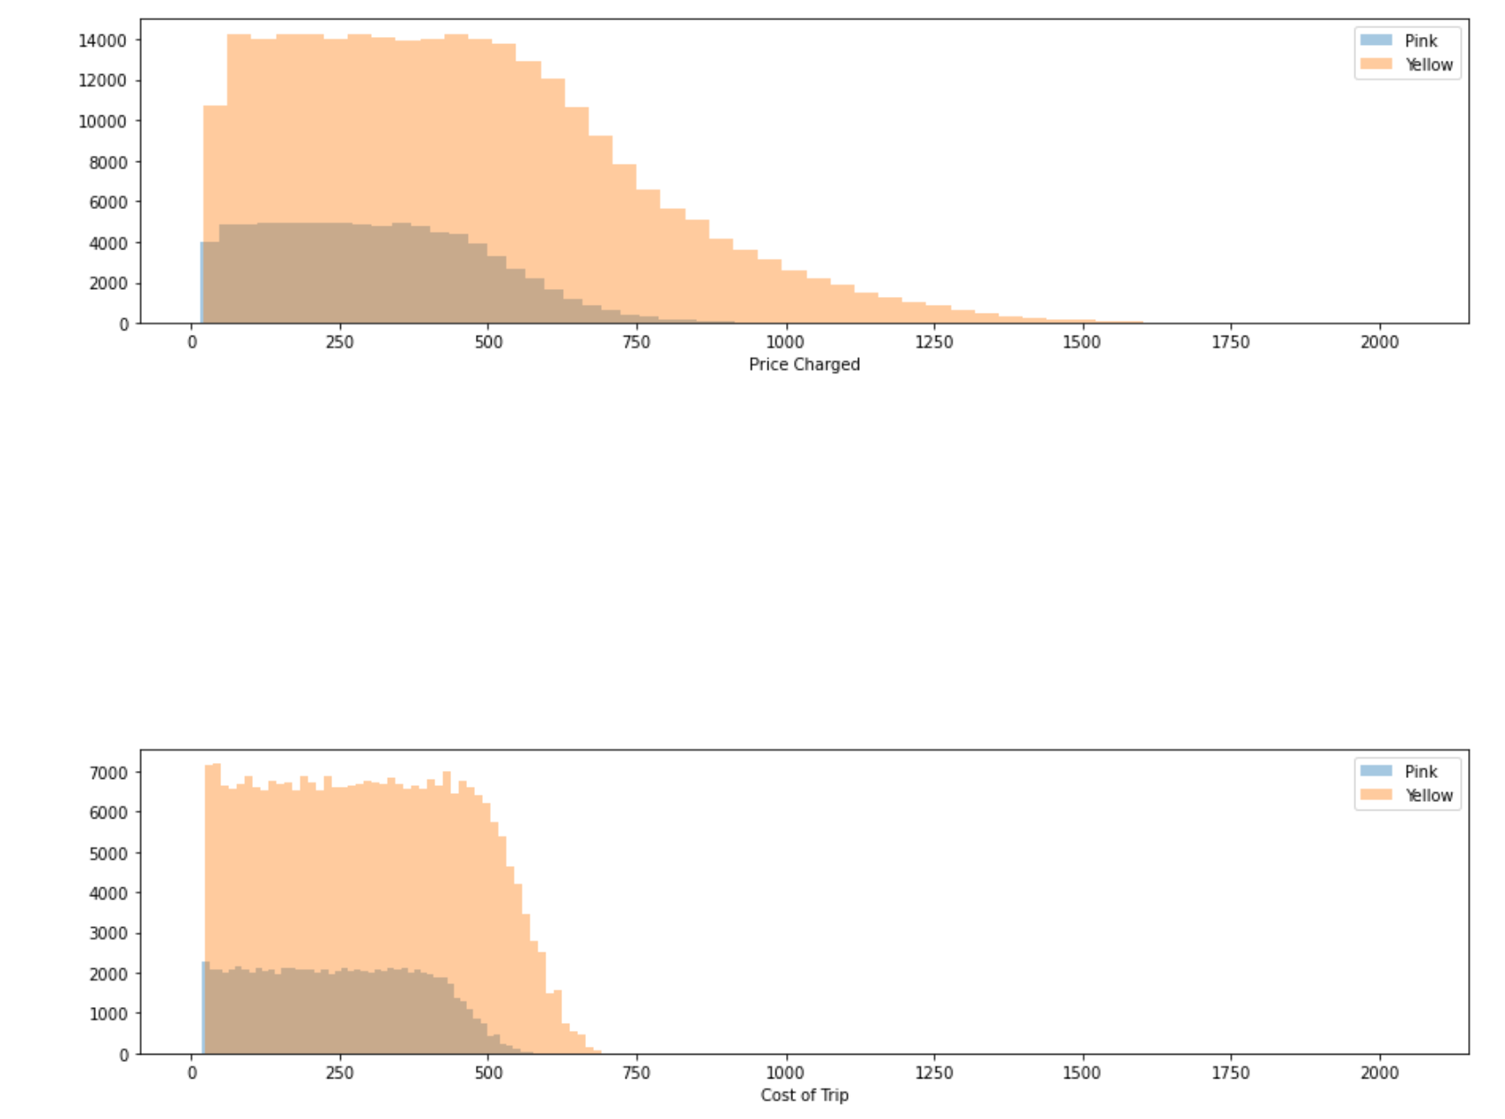
Company EDA 3
Yellow has a larger range than pink, meaning yellow has a more variable price charged.
Since profit will be an essential factor towards investment feasibility, looking at the distributions of cost of trip and price charged will be essential.
Cost of trip seems to be higher, but with less range. When noticing the difference between both, we can see that yellow will end up having more revenue within this study.

Slide 10
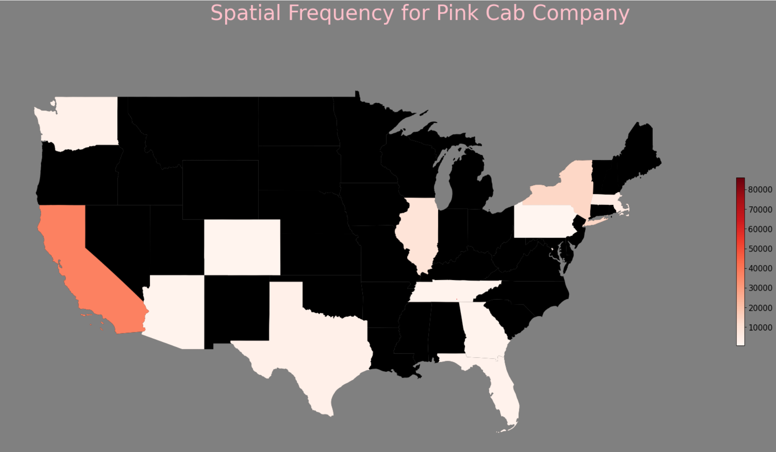
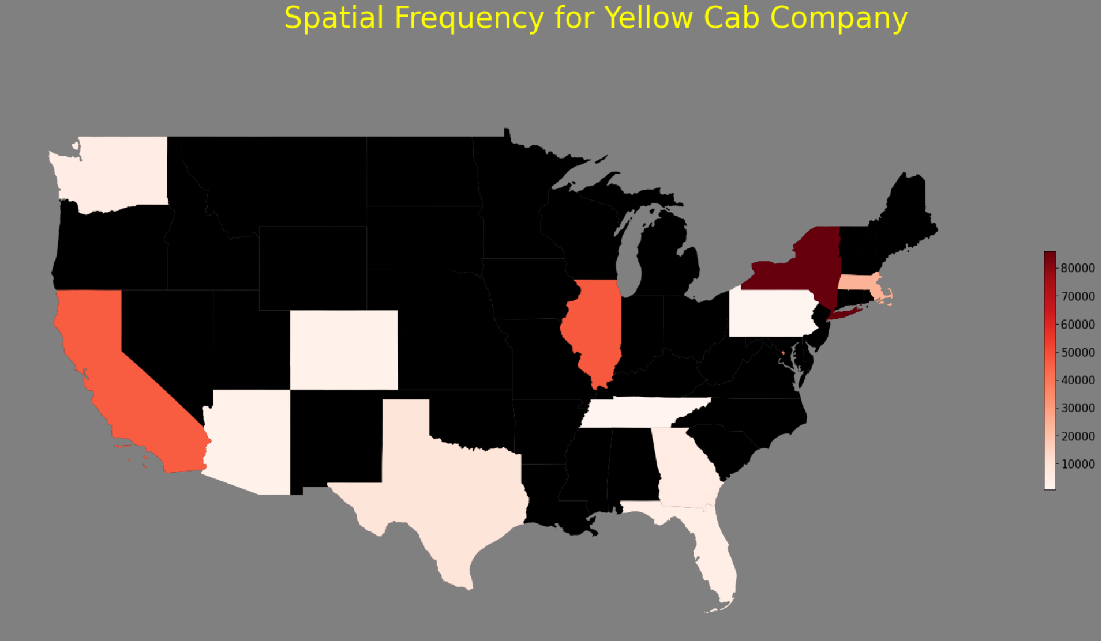

Which company has more spatial control in the United States?
Overall, Yellow is seen to have more customer control throughout all regions of the United States. The more prominent differences are seen in states such as California, Illinois and New York.

Slide 11
Profit Based on State

Slide 12
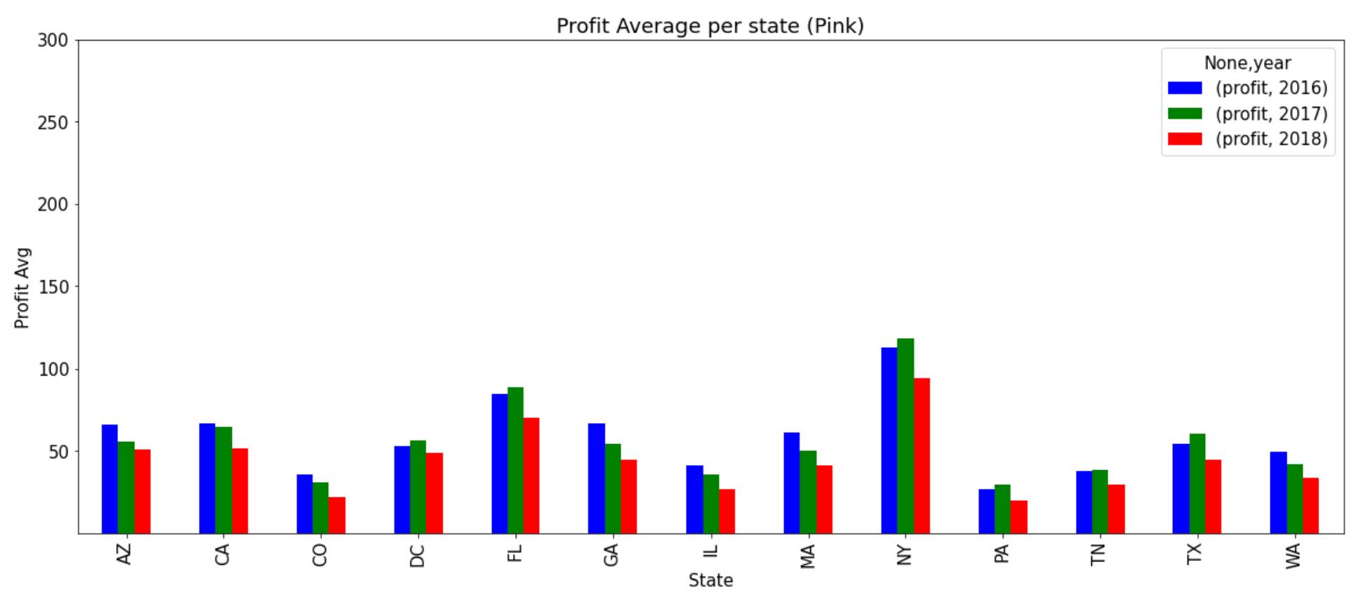
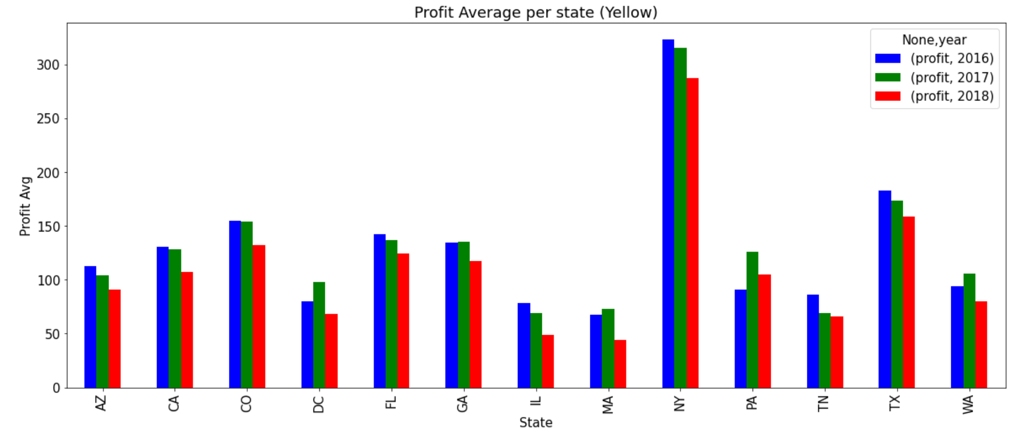
Profit Average Based on State, Per Year
Between both companies, there is a definite difference between the amount of average profit. New York is seen to be the most profitable, however, considering the holistic view of all states, Yellow has gained a more noticeable profit margin.

Slide 13
Profit Average based on State, per Year 2
However, there is a noticeable downward trend for 2018’s average profit compared to all of the other years. This may give a thorough prediction for future forecasting.

Slide 14
Customer Characteristics Based on Profit

Slide 15
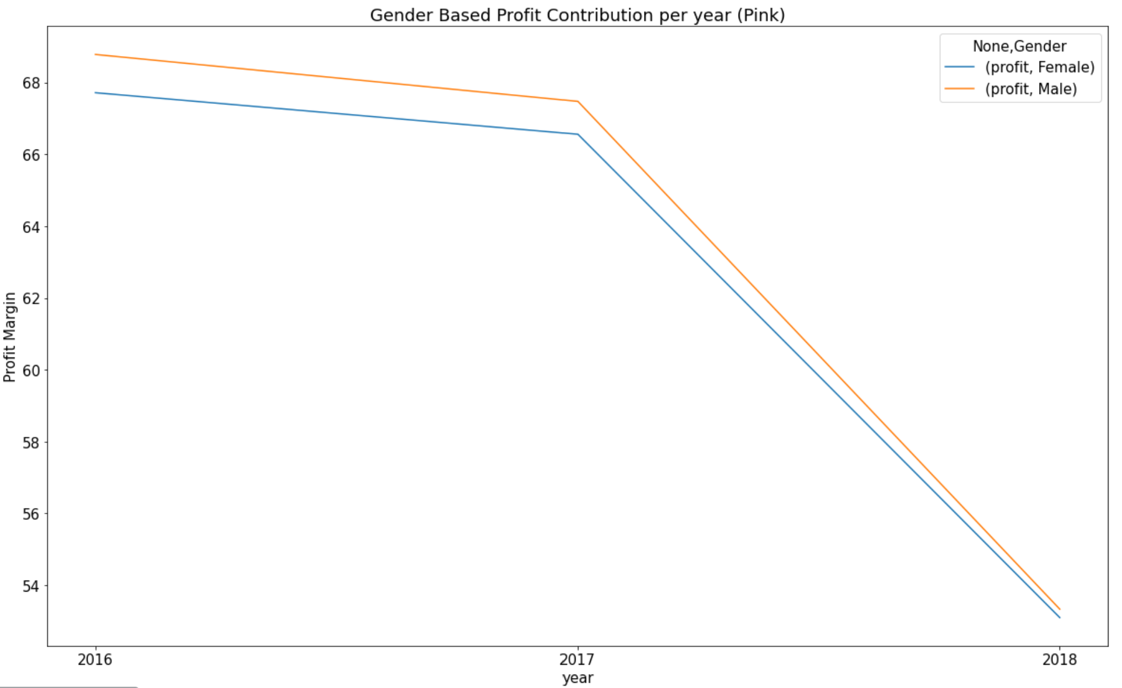
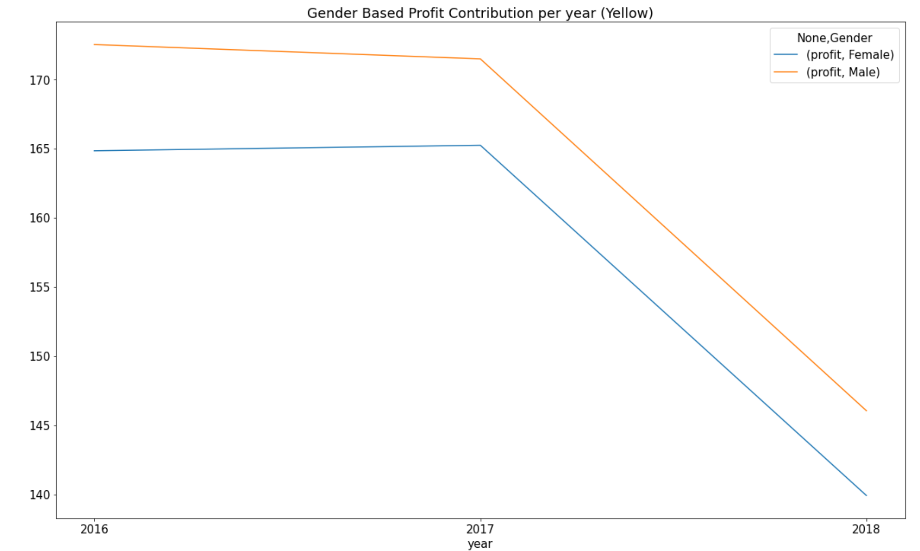
Gender Based Profit Contribution Per Year
Pink has a much closer distribution of genders, giving a similar profit margin per year compared to Yellow. However, both still have a higher male contribution, which may contribute to a higher population of males using these services.

Slide 16
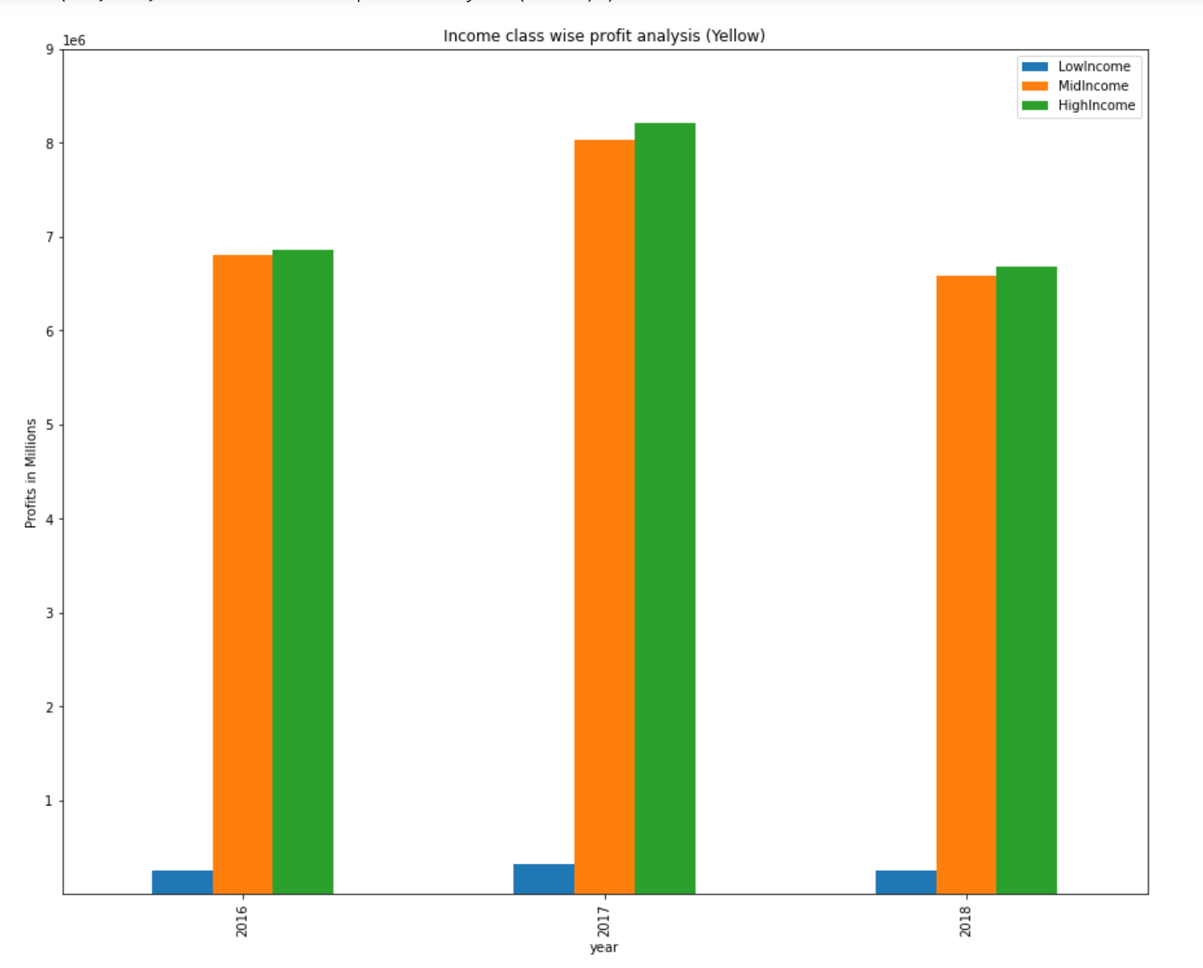
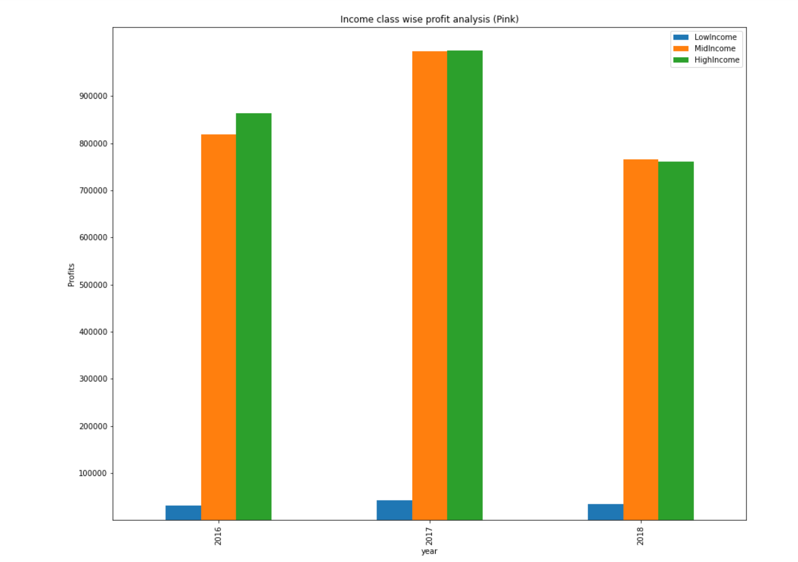
Income Class wise Profit Analysis
Millions
Most of the middle and high-income classes generate the most revenue for both companies.
The distribution per year is even across all income classes, however, Yellow has had the most profit overall.

Slide 17

Customer Retention

Slide 18
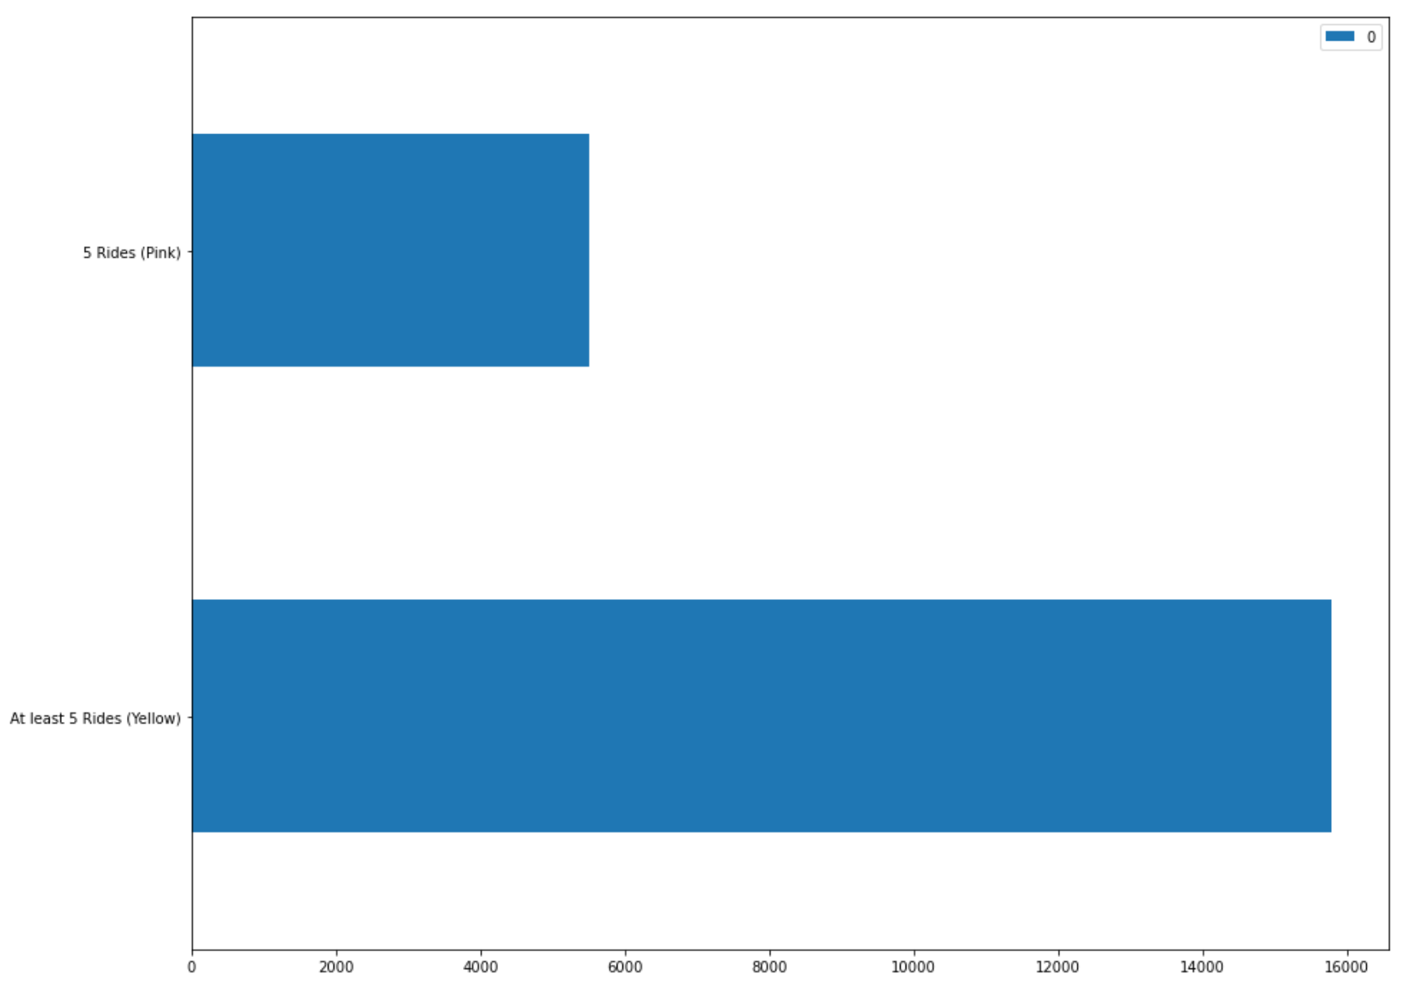
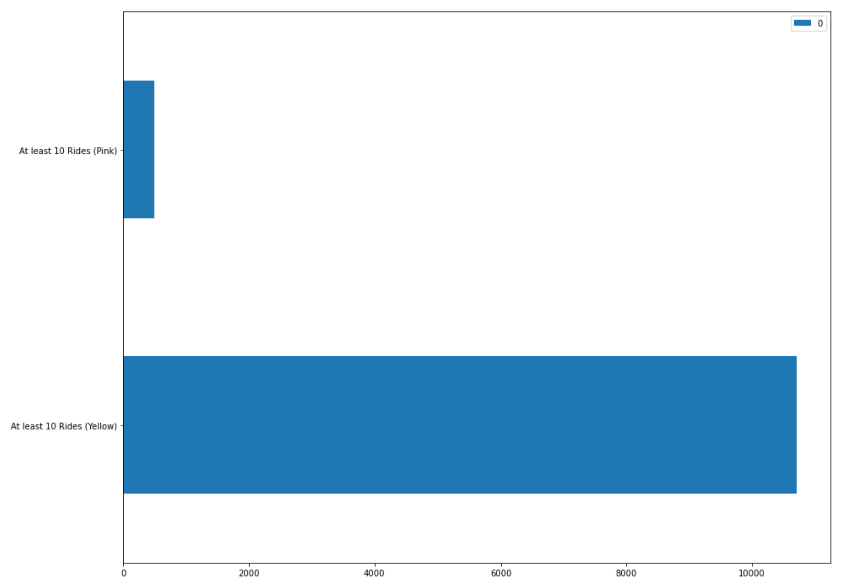
Customer Retention
Though the scaling is different, we are looking at the difference between people who have had at least 5 rides versus 10 rides.
Customer loyalty has had more of an impact on Yellow’s side compared to Pink.

Slide 19

Profit Analysis For Pink and Yellow

Slide 20
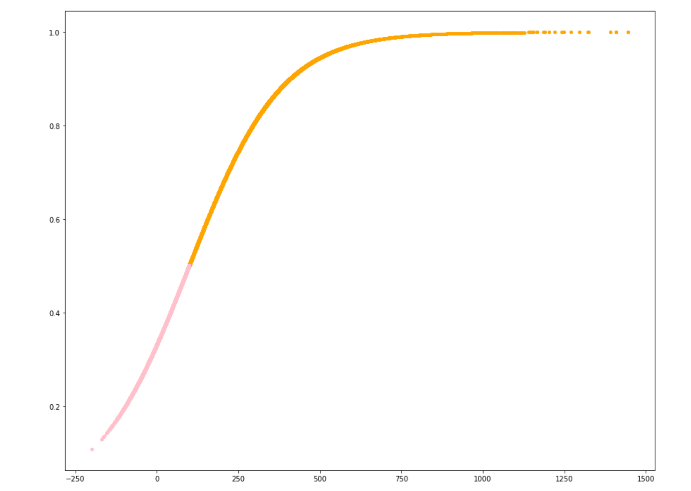
Probability Regression (Which company has the highest probability to gain the most profit)
Orange – Yellow Co
Pink – Pink Co
Probability * 100
Using a logistic regression, we can see that the Yellow company has a higher probability of obtaining a higher profit margin compared to the Pink Company.
Profit Margin
Disclaimer: Negative numbers are included; however, this may be due to the loss of profit that Pink Company may have endured.

Slide 21
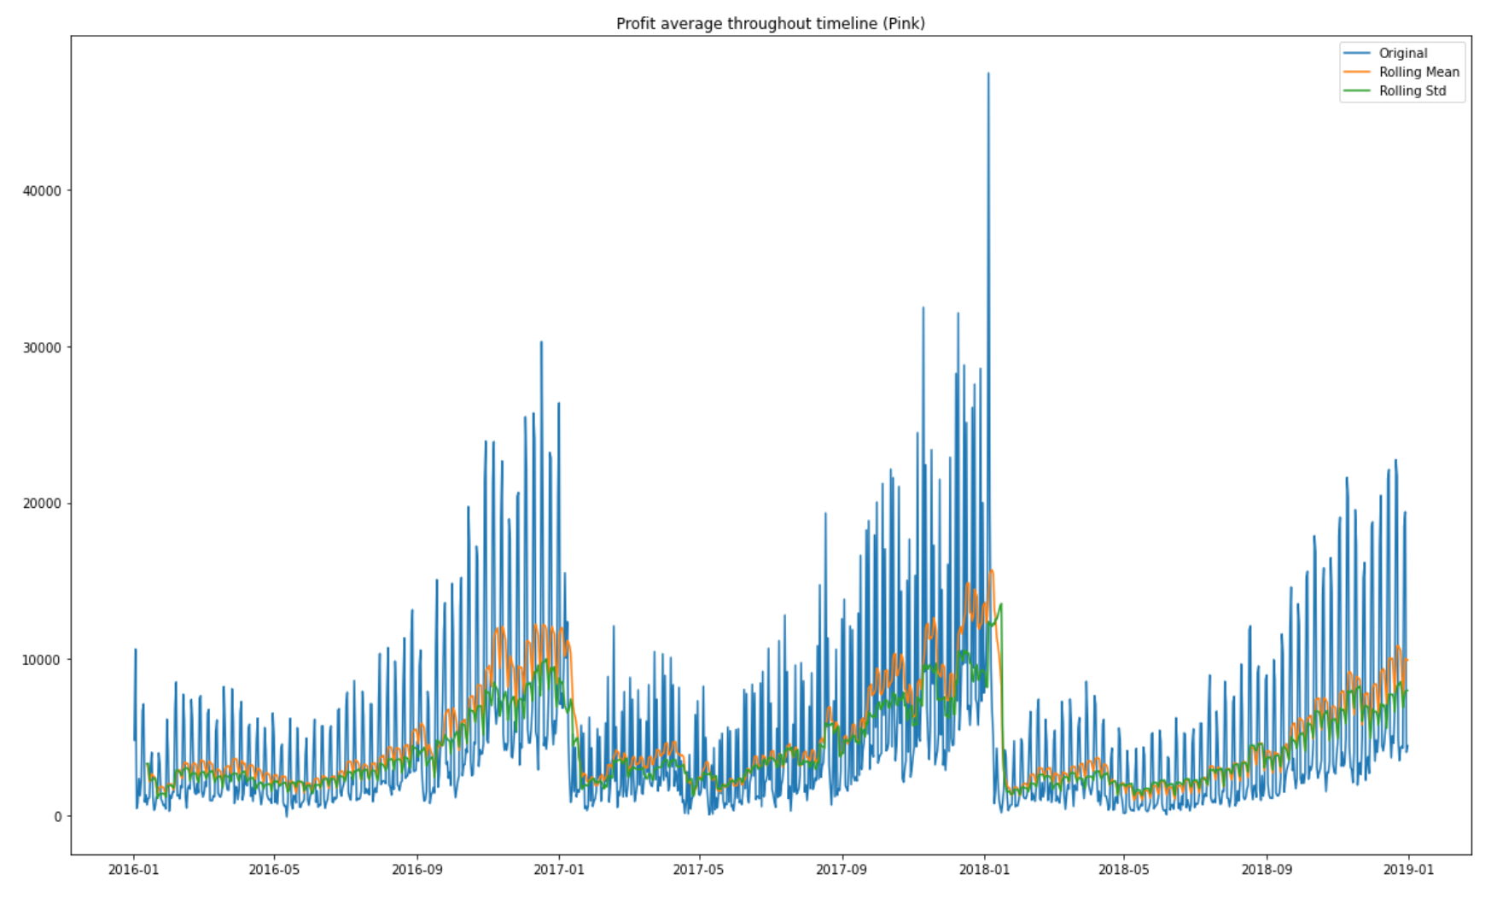
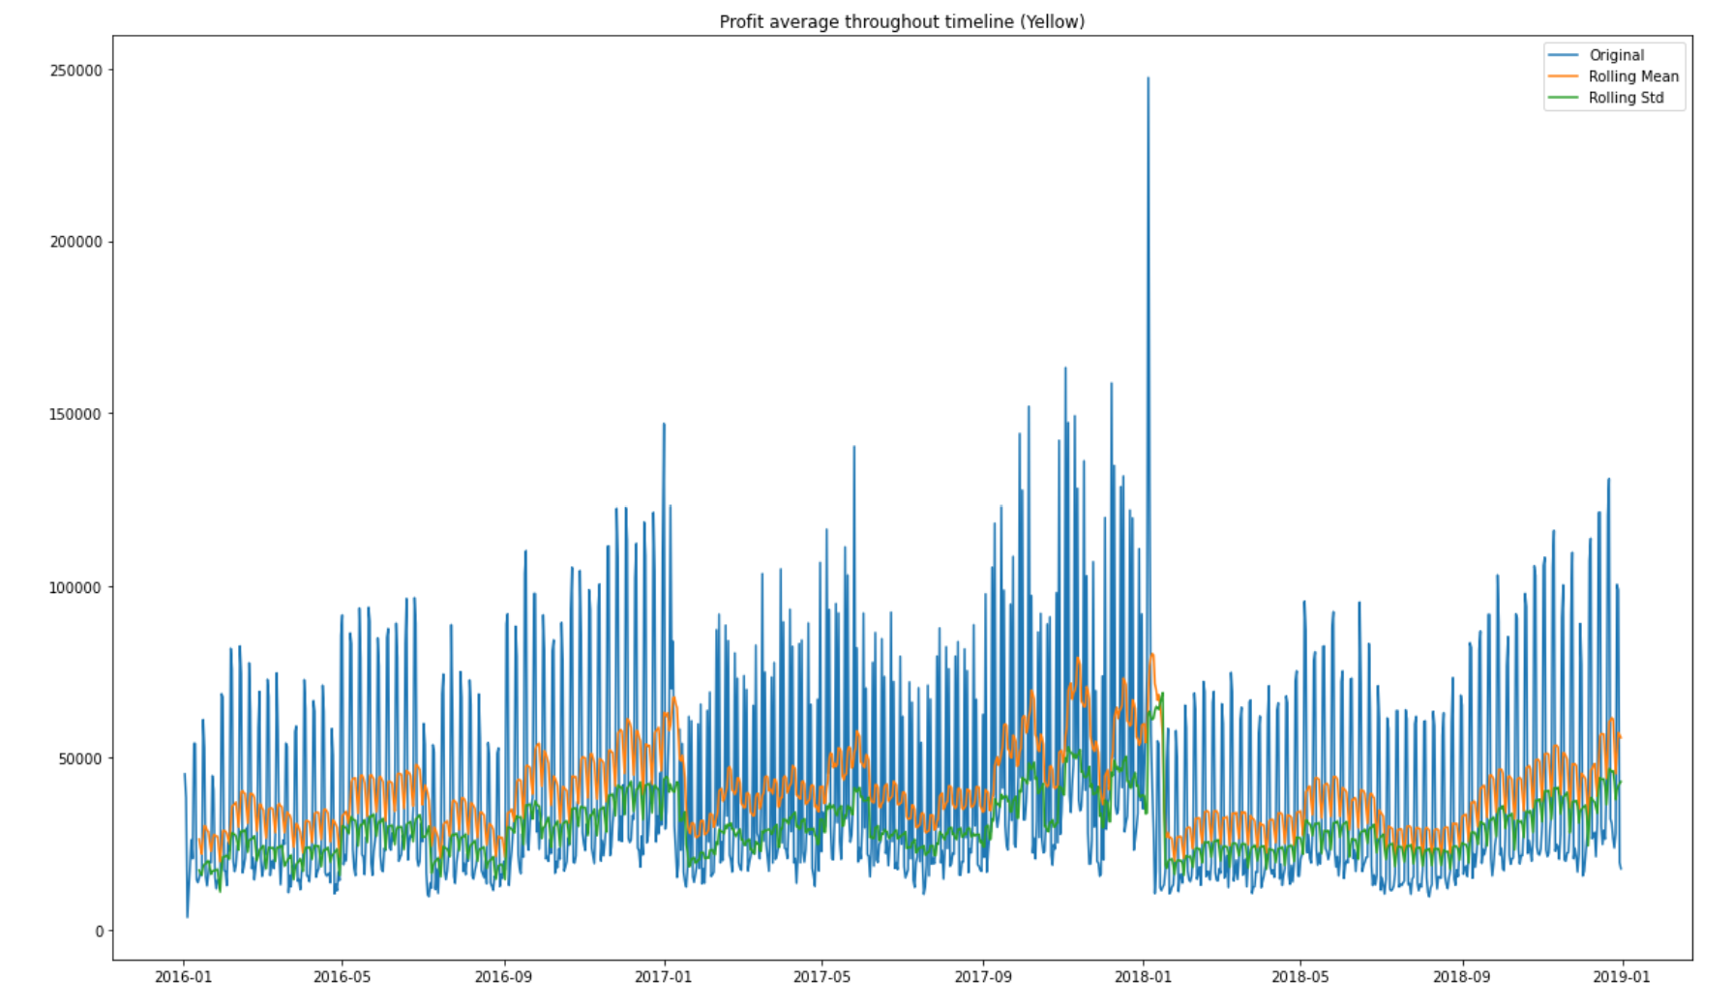
Time Series Trend
Both taxi companies have seasons of increase towards the beginning of the year, however, we can see that Yellow has had more variations in the amount of profit that they obtained.

Slide 22
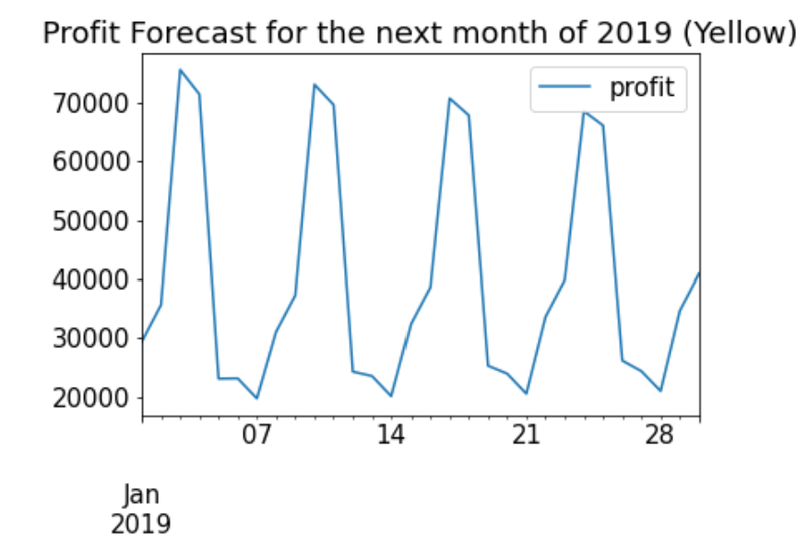
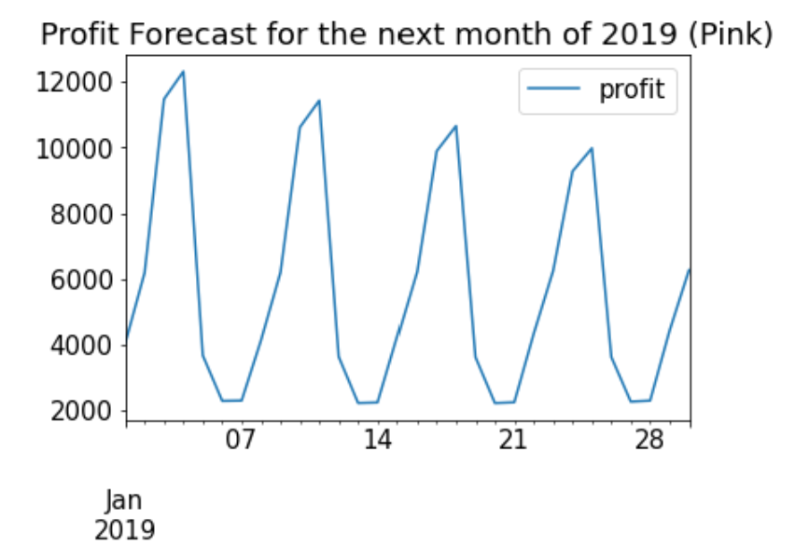
Time Series Forecasting for the Next Month
Using an autoregressive model, we can see that both companies seem to fluctuate in profits.
This predicted profit is diminishing over time.

Slide 23
Spatial Factor Recommendations
Spatial Control
Having a holistic focus throughout the United States can be crucial for revenue.
Yearly State Profit Control
Per year, Yellow makes a higher profit margin for each state compared to Pink.
Though there is a large cluster in New York, all the other states exhibit much larger proportions than Pink.
It is safe to say that the Yellow company has more of an outreach compared to Pink, by a large margin.

Slide 24
Customer Characteristic Recommendations
Gender Based on Profit
There seems to be a distinctive gap between genders for Yellow compared to Pink.
Income Based on Profit
Both companies have a majority of the Middle and High classes.
This may be a cause for concern, as Pink has had all genders contribute the same amount per year compared to Yellow.
When it comes to scaling, Yellow still manages to bring more profit from both genders.
The distribution is almost indistinguishable, however, Yellow still manages to create an impressive profit from all social classes.

Slide 25
Customer Retention Reccommendation
Yellow has had a larger frequency of more loyal customers compared to Pink, which would mean that the majority of customers will most likely stick with Yellow compared to Pink.

Slide 26
Profit Recommendations
Forecasting
Based on the given graphs, both companies seem to diminish over time.
This could be regarding other competitors coming into the market. (Uber)
However, since Yellow has larger scaling than Pink, they are still projected to lose, but not as much as Pink.

Slide 27
Conclusion
Based on the compelling insights, our conclusion for which company XYZ should invest in would be Yellow.

Slide 28

Thank You

